Slide 1
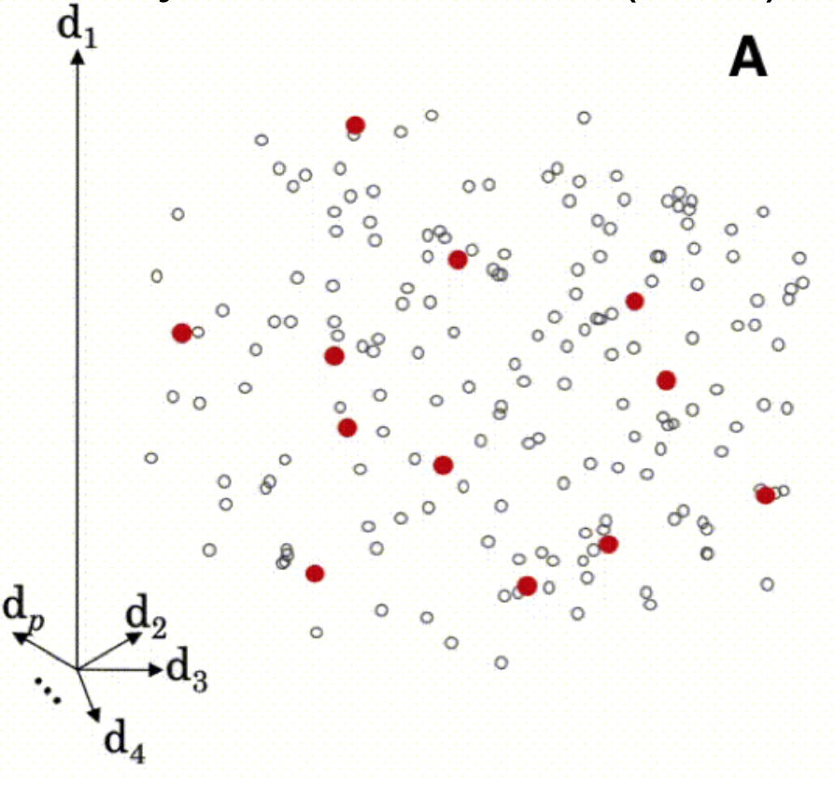
Memory Based Learner (MBL)
A local modeling approach
For each sample in the prediction set, mbl finds the samples in the reference set most similar to the sample at hand, makes a model with these samples, and returns the output prediction
f1
(Alternative- not a local model)

Slide 2
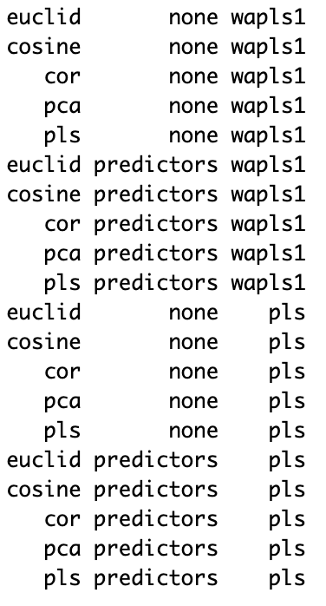
Ensemble Script
20 Combinations
5 x 2 x 2
Methods for determining similarity
Ways to use similarity matrix
Methods for the local regression models
euclid
cosine
cor
pca
pls
none
predictors
wapls
pls
Example script READ-ME
/mnt/data2/disk1/soilcarbon/crivard/predEnsemble/ensemble_example

Slide 3
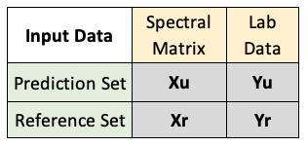
Input Datasets
A local modeling approach
For each sample in the prediction set, mbl finds the samples in the reference set most similar to the sample at hand, makes a model with these samples, and returns the output prediction
One Spectral Library
80% calibration (reference set)
20% validation (prediction set)
Two Spectral Libraries:
KSSL library (reference set)
Rodale spectral data (prediction set)
Lab data for your prediction set is not required, but useful for validating the model

Slide 4
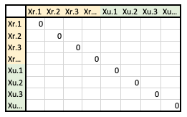
Similarity Matrix
A local modeling approach
For each sample in the prediction set, mbl finds the samples in the reference set most similar to the sample at hand, makes a model with these samples, and returns the output prediction
How does the model determine nearest neighbors?
euclid
cosine
cor
pca
pls
Ways of measuring distance in multidimensional space
How is similarity information used?
none
predictors
The matrix is added as a predictor variable when modeling

Slide 5
Neighbor selection
A local modeling approach
For each sample in the prediction set, mbl finds the samples in the reference set most similar to the sample at hand, makes a model with these samples, and returns the output prediction
How many nearest neighbors does the model pick?
Fixed number of neighbors
k= seq(40, 100, by = 20)
Fixed distance
k.diss = seq(0.3, 1, by=0.1)
Combo of the two

Slide 6
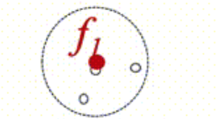
Local modeling
Validation Methods
A local modeling approach
For each sample in the prediction set, mbl finds the samples in the reference set most similar to the sample at hand, makes a model with these samples, and returns the output prediction
PLS
(Partial Least Squares Regression)
WAPLS
(Weighted Average Partial Least Squares Regression)
*Uses the nearest neighbors in the calibration set to validate*
NNv (leave-nearest-neighbour-out cross validation)
loc_crossval (local leave group out cross validation)
none (If you chose not to validate the model. This will improve processing speed)

Slide 7
MBL Modeling Resources
Woodwell guide (not updated to resemble 2.0)
https://whrc.github.io/Soil-Predictions-MIR/mbl-models.html#modeling-parameters
Resemble 2.0 package vignette (updated, very helpful!)
https://cran.r-project.org/web/packages/resemble/vignettes/resemble.html#8_Regression
mbl_control() function
https://rdrr.io/cran/resemble/man/mbl_control.html
mbl() function
https://www.rdocumentation.org/packages/resemble/versions/2.0.0/topics/mbl

Slide 8
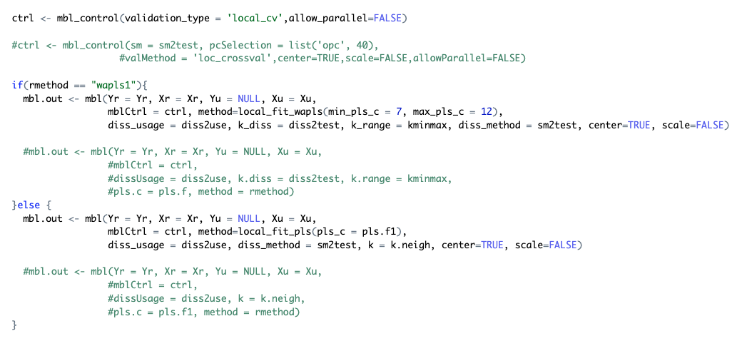
Changes with Resemble 2.0
(green is code from the old resemble package)

Slide 9
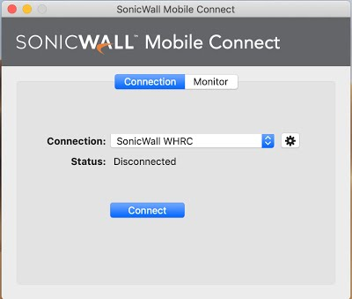
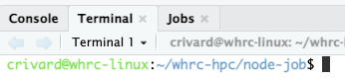
Running the code
Connecting to the VPN with sonic wall connect (Woodwell intranet)
Link for RStudio connect http://10.208.52.13:8787
Example ensemble script (copy to your folder) READ-ME
/mnt/data2/disk1/soilcarbon/crivard/predEnsemble/ensemble_example
Using the terminal to submit a kubernetes job
Move to the node-job directory
cd ~/whrc-hpc/node-job
Run Job (prompts you to submit)
./run_job.sh
Check current jobs running
kubectl get pods -n whrc
Check logs/errors to your jobs
kubectl logs "pod-name" -n whrc
Delete jobs (frees up space for new jobs)
kubectl delete pods "pod-name" -n whrc
Site for monitoring CloudOps usage (storage and memory available)

